Slide 1
“Building Better Attendance”
GMBC of GA 7th District
Rev. Carlos Calhoun, H4 Ministries

Slide 2

Building Better Attendance
“When our churches intentionally meet the needs of our communities, we become a visible expression of God’s love. Through service, compassion, and meaningful engagement, we demonstrate that ministry extends beyond the walls of the church and has the power to make a lasting impact in people’s lives.”

Slide 3

Download Your Copy
Text “BUILDING” to 855.304.0867
Or
Scan QR Code

Slide 4


Introduction
4 Partnership for Pillars Connecting with our local community through these 4 pillars provides an opportunity Build Better Attendance.,
Education Early Childhood, K12, & Higher Ed
Business Job Fairs, Bible Studies, & Grief Support
Healthcare Health Fair, Health Screening, & Awareness Days
Nonprofits Volunteering, Food Banks, & Clothing Assistance

Slide 5
“Discover the need that you meet and you will have uncovered your
Divine purpose!
Tip
By shifting the focus from what we want, to what they need we create a natural & organic process for church growth.

Slide 6
The Faith Foundation.
Our Efforts Must Be Biblically Based
Our Efforts Must Be Bathed in Prayer
Our Efforts Must Be Authentic to our Culture
Tip
The church in not Monolithic. There is not a one size fits all approach to ministry. The approach and principles may be adjusted to work in your particular context.

Slide 7
Education
There’s an existing conduit place in our communities. We only need to take advantage!
Adopt a School
Partner with the school at a high level. Make it difficult to distinguish where one starts and the other begins!
Campus Ministry
Bring the ministry to the school if permitted. After school programs, bible studies, and parenting classes.

Slide 8
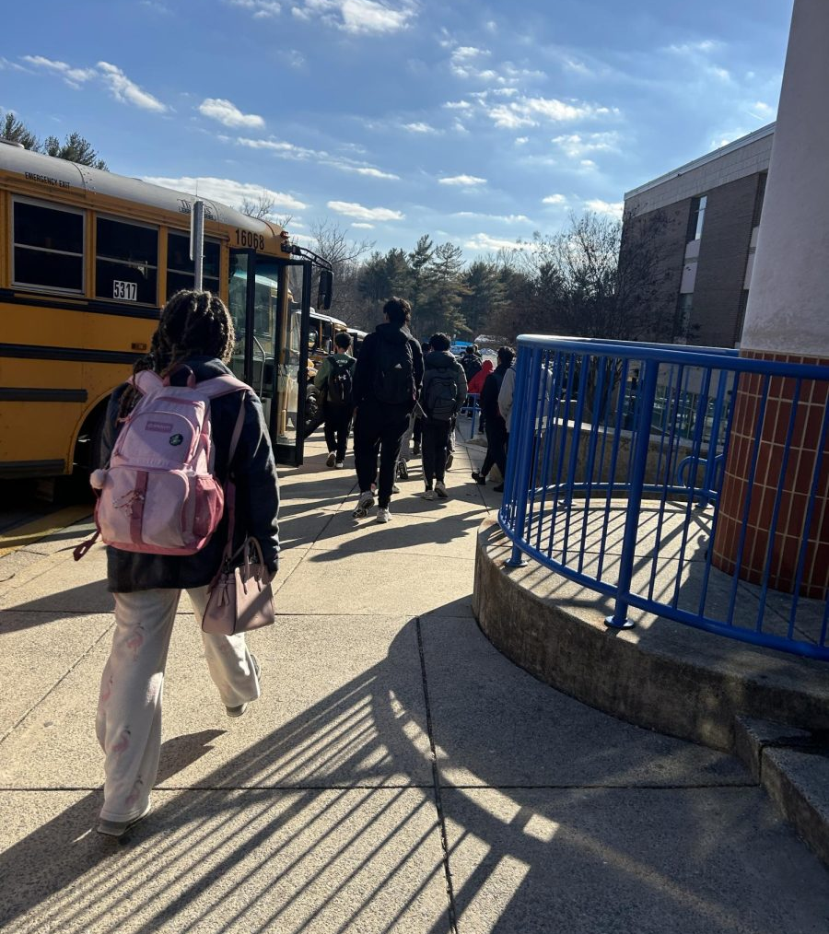
The Bus Loop
Some schools allow community volunteers to assist with the bus loop and parent drop off in the morings.
Tip
Our schools systems are tasked with many responsibilities that they are not equipped to manage. They will often welcome volunteers to supplement their staff.

Slide 9
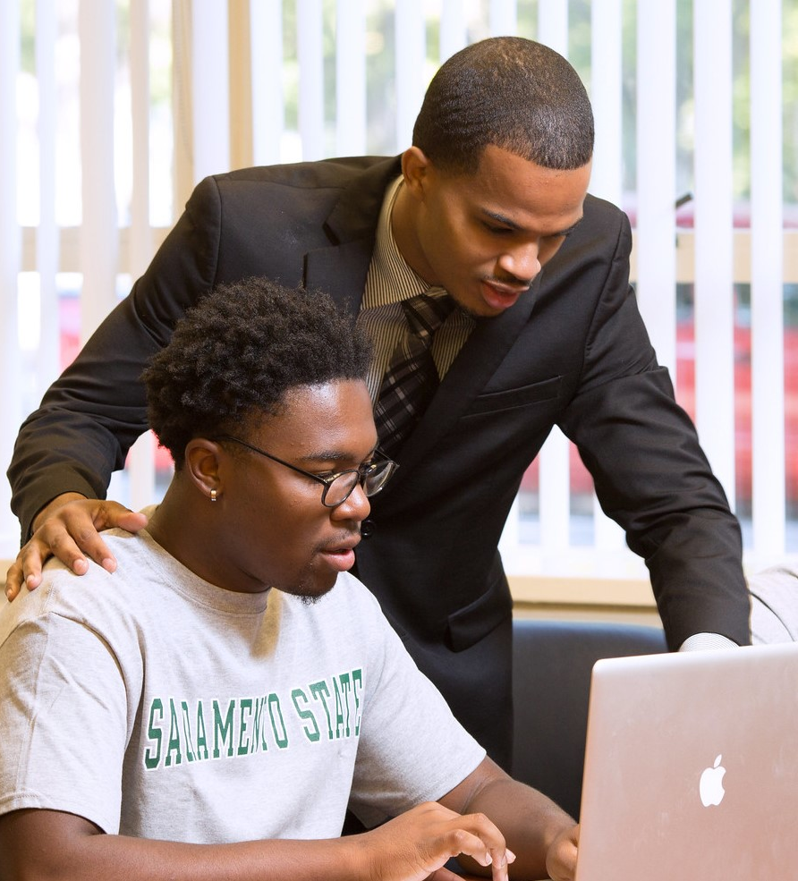
School Mentors
School mentoring pairs students with supportive adults or older peers to build life skills, boost academic confidence, and improve attendance.
Tip
Mentors have the ability to build a bond with a student but can also impact other students during the school visits. .

Slide 10
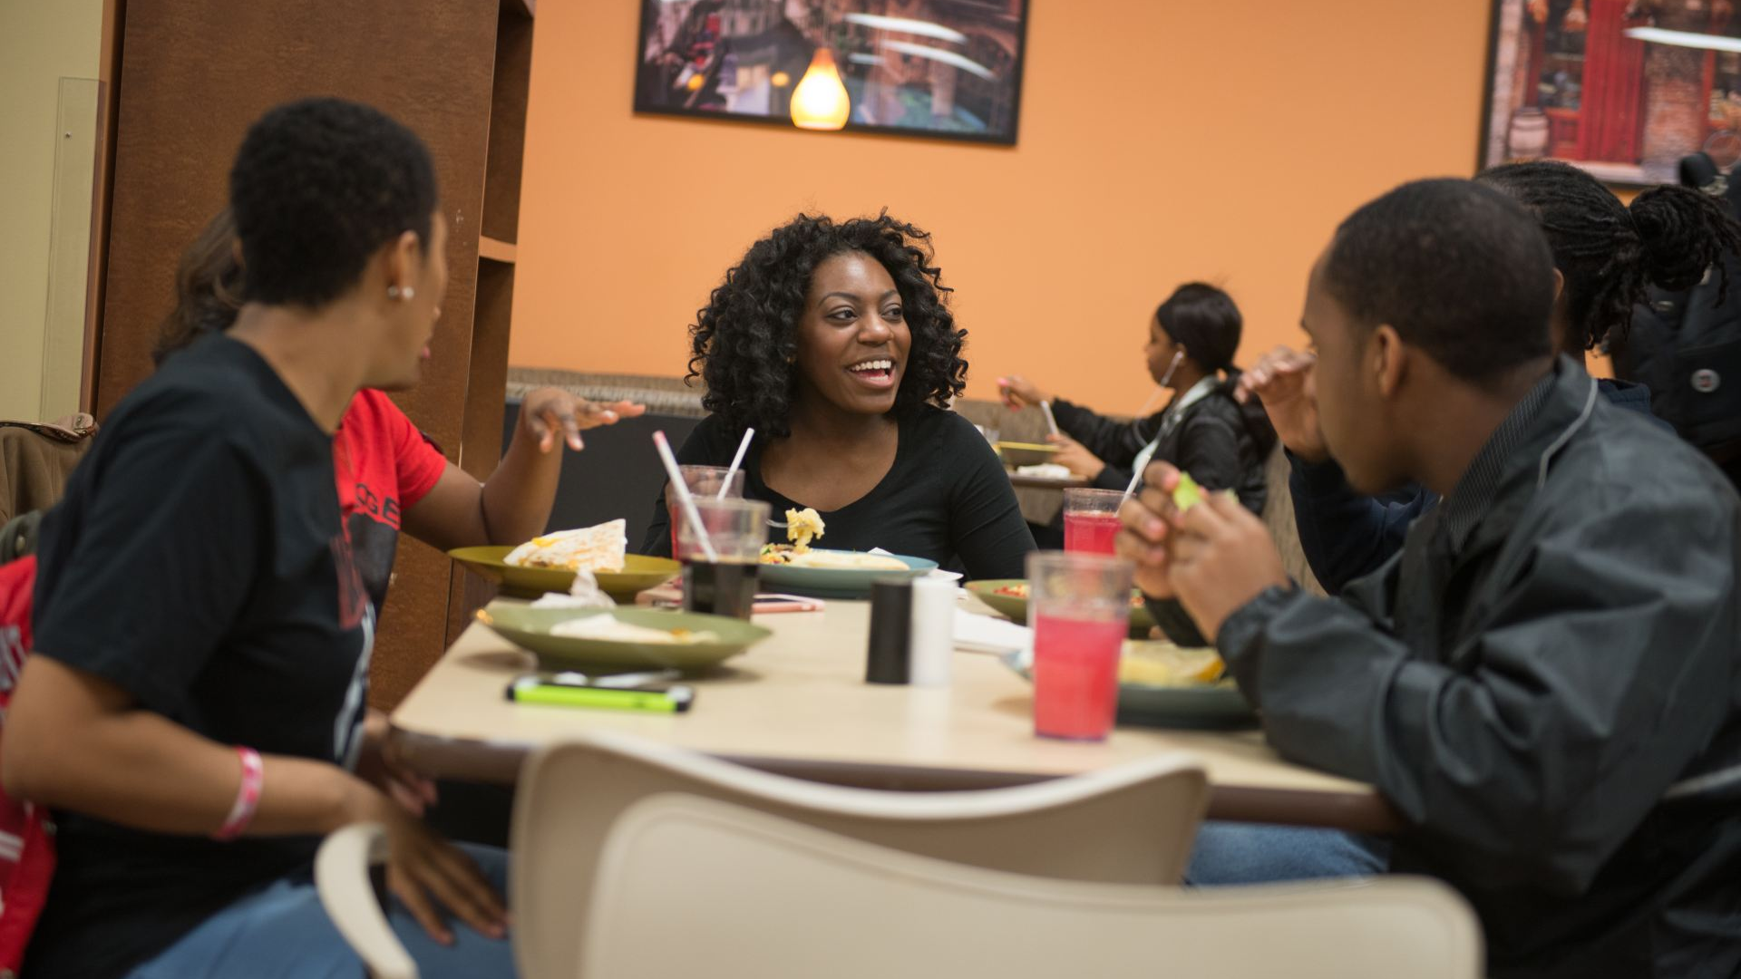
Many College Students Struggle Financially and Something as Simple as a Meal can Mean a lot.
Tip
K. I. S. S. Keep it simple Saints! Sometimes simple gestures can be impactful and memorable. Provide a meal, remember their names, offer transportation to the store.

Slide 11
Business
Although many workplace policies forbid forced or mandatory religious practice. Many are open to optional faith based meetings.
Workplace Evangelism
Workplace relationship can often be meaningful and impactful. We often have an opportunity to exemplify our faith through these relationships.
Offer to Help
The church can provide a valuable connection to the workplace. Many employers believe that people of faith make great employees.

Slide 12

Unsupported grief in the workplace costs U.S. companies up to $225.8 billion every year due to lost productivity, absenteeism, and turnover.
Tip
We must learn to speak the language of our target audience. The church has much to offer but we must learn to express the value of our offering.
Source: USAToday

Slide 13
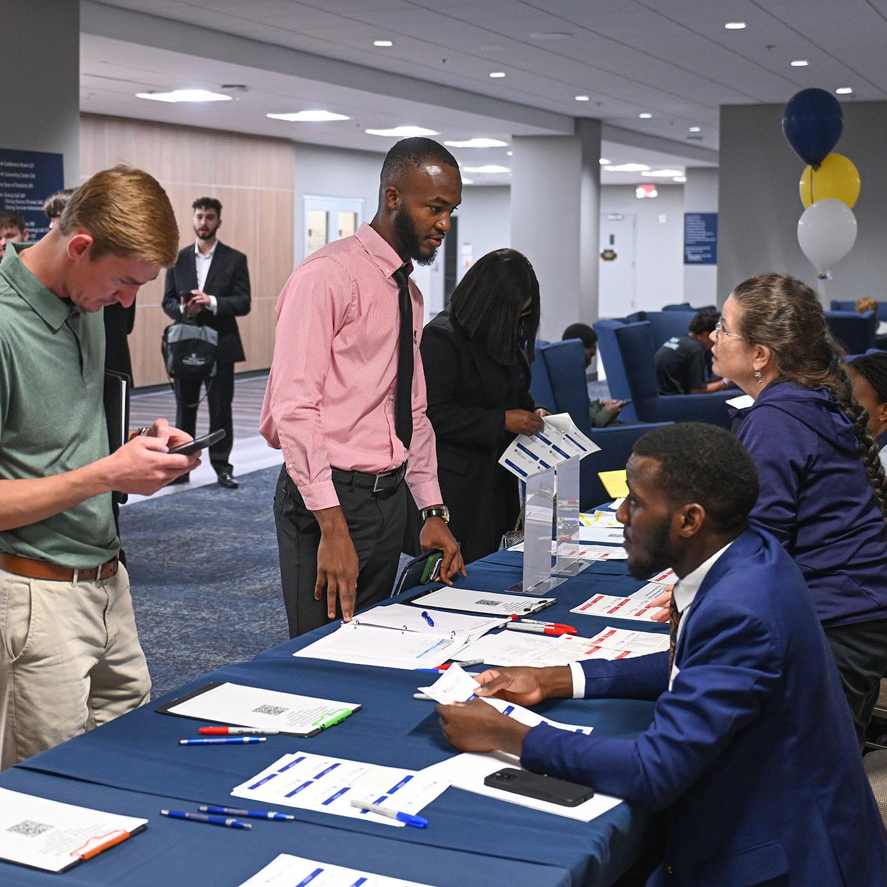
Job Fair
Churches are a great place to host a job fair. Churches are often seen as a hub for the local community. By bridging the gap between finances and faith, the church provides a valuable necessity.
Tip
The ability to build strong relationship with other community partners is paramount and could be mutually beneficial.

Slide 14
Healthcare
Many Americans face challenges accessing trustworthy, affordable healthcare and may be unaware of the resources available to meet their needs.
Community Health Fair
Hosting a community health fair may be a great opportunity to provide much needed resources to your community.
Awareness Days
Dedicating time during church gatherings to raise awareness about specific health concerns is a meaningful way to educate, support, and connect with the community.

Slide 15

The United States is facing a growing health care affordability crisis. In 2024, national health expenditures totalled $5.3 trillion, or $15 474 per person, accounting for 18.0% of the U.S. economy.
Tip
Jesus fed the multitudes to meet their physical needs in conjunction with ministering to them to meet their spiritual needs.
Source: AHA ASA Journals

Slide 16

Awareness Days
Churches can partner with local organizations to recognize annual health awareness days, providing education and resources for health conditions that impact individuals and families throughout our congregations and communities.
Tip
The church has faced criticism for being disconnected from the community. We must intentionally create opportunities to reconnect, serve, and build meaningful relationships.

Slide 17
Nonprofits
By providing volunteers, for nonprofit organizations churches can turn ministry into action and make a community impact..
Food Distribution
Churches can work with nonprofits to connect people with much needed food resources.
Community Closets
Limited or insufficient income creates financial challenges for many families. Providing access to clothing closets can help meet needs and ease the burden on struggling households.

Slide 18

Food insecurity in the United States affects approximately 47.9 million people, meaning 13.7%—or about 1 in 7—households face uncertain access to adequate food.
Tip
Due to space limitations many churches do not have room for food pantries and clothing banks. Partnering with nonprofits s may be be a great way to serve the community’s needs.
Source: https://frac.org/news/usdafoodsecurityreportdec2025

Slide 19
Download Your Copy
Text “BUILDING” to 855.304.0867
Or
Scan QR Code

